Slide 1
PREDICTION OF EMPLOYEE ATTRITION USING MACHINE LEARNING & PYTHON
BATCH NUMBER-27
P HEMALATHA -211419104100
S KAVYA -211419104135
GUIDE NAME:
MRS.A KANCHANA M.E

Slide 2
PROBLEM STATEMENT
Employees are the most important part of an organization. Successful employees meet deadlines, make sales, and build the brand through positive customer interactions.
Employee attrition is a major cost to an organization and predicting such attritions is the most important requirement of the Human Resources department in many organizations. In this problem, Our task is to predict the attrition rate of employees of an organization.

Slide 3
ABSTRACT
Employee attrition is when an employee leaves the company through any method, including voluntary resignations, layoffs, failure to return from a leave of absence, or even illness or death.
Every organization has its own productivity and strength which stands on the legs of the employees.
Keeping regular employee is a great challenge for all organization in the competitive world.
Employee Attrition is one of the biggest business problems in HR Analytics.
Predicting whether a particular employee may leave or not will help the company to make preventive decisions.
Companies invest a lot in the training of the employees keeping in mind the returns they would provide to the company in the future.
If an employee leaves the company, it is the loss of opportunity cost to the company.
These study interpreters the employee’s attrition rate through the related attributes like Age, Monthly income, overtime etc.. affect the attrition largely.
This project works on employee attrition prediction using machine learning by random forest algorithm.

Slide 4
INTRODUCTION
Employee attrition is also known as Labour attrition.
Attrition defined as employment loss such as sudden resignation, personal health , or other similar reasons.
Losing an talented and well trained employee drastically effects the organization regarding in making an employee more skillful.
The attrition rate tends to vary from skilled and unskilled labours .
Whenever there is a hiring of new employee then at that period of time there is increase in cost of recruitment and training.
It is the keen responsibility of the HR manager to hire a well natured , faithful, trained and workaholic employees are required to run a successful organization.
The employee should have a best knowledge about his work which is assigned to him so as to upgrade the company abundantly.
By keeping aspect of all these possibilities we are providing preventive techniques that are required to decrease the attrition rate and update it to Manager.

Slide 5



1.HOW TO REDUCE EMPLOYEE CHURN?
2.WHY ARE GOOD EMPLOYEES LEAVING THE COMPANY?
3.HOW TO RETAIN THE TALENTED EMPLOYEES?

Slide 6
LITERATURE SURVEY
Research Authors | Problem studied | Techniques Studied | Recommend
Nagadevara , Srinivasan and Valk[10] | Relationship of withdrawal behaviors like lateness and absenteeism, job content, tenure and demographics on employee turnover | Artificial neural networks, logistic regression, classification and regression trees (CART), classification trees (C5.0), and discriminant analysis) | Classification and regression trees (CART)
Hong, Wei and Chen[11] | Feasibility of applying the Logitand Probitmodels to employee voluntary Turnover predictions | Logistic regression model (logit), probability regression model (probit) | Logistic regression model (logic)
Marjorie Laura Kane Sellers[12] | To explore various personal, as well as work variables impacting employee voluntary turnover | Binomial logit regression | Binomial logit regression
Alao and Adeyemo[13] | Analyzing employee attrition using multiple decision tree algorithms | C4.5, C5, REPTree, CART | C5 decision tree
Saradhi and Palshikar[14] | To compare data mining techniques for predicting employee churn | Naïve Bayes, Support Vector Machines, Logistic Regression, Decision Trees and | Support Vector Machines

Slide 7
EXISTING SYSTEM
Employee attrition prediction by using various classification algorithms like logistic regression, LDA, SVM, KNN to predict the probability of attrition of any new employee.
Deep learning technique along with some preprocessing steps to improve the prediction of employee attrition.
Several factors lead to employee attrition.
Such factors are analyzed to reveal their intercorrelation and to demonstrate the dominant ones.

Slide 8
PROPOSED SYSTEM
Employee attrition prediction like Random Forest algorithm to predict the probability of attrition of any new employee.
As a result, training balanced dataset with Random Forest achieved highest performance with highest accuracy.
This was tested using the imbalanced dataset, which contains 35 features for 1470 employees.
To get realistic results, balanced version from the original one has been derived.
Finally, cross-validation is implemented to evaluate the work precisely.
Extensive experiments have been conducted to show the practical value of our work.
The prediction accuracy using the original dataset is about 91%, whereas it is about 94% using a synthetic dataset.

Slide 9
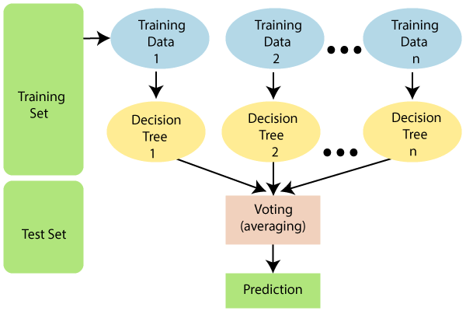
RANDOM FOREST ALGORITHM
Random Forest is a supervised learning algorithm which is used for both classification and regression problems.
It is an ensemble of Decision trees.
Random forest is a classifier that contains a number of decision trees on various subsets of the given dataset and takes the average to improve the predictive accuracy of that dataset.
The datasets are split into two subsets.
The first subset is known as Training dataset.
The second subset is known as Testing dataset.

Slide 10
MODULES
1.Importing libraries that will be used throughout this program.
i. numpy
ii. pandas
iii. seaborn
2. Loading the data.
3. Storing the data into a dataframe.
4.Get the number of rows and columns in the data.
#There are 1470 rows of data or employees in the data set and 35 columns or data points on each employee.

Slide 11
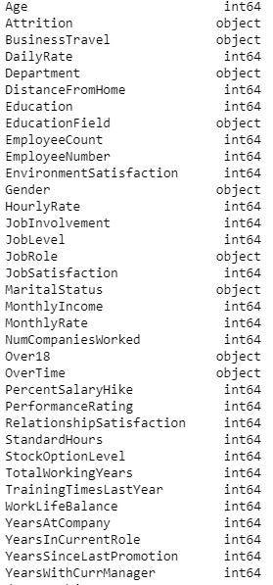
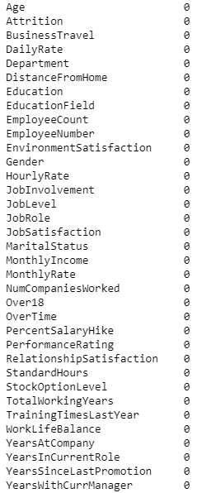
5. Get the column data types.
6.Get a count of the number of empty values in each column.
Here there is no missing data since all of the columns are returning a value of 0. Let’s double check the data set for any missing values.

Slide 12
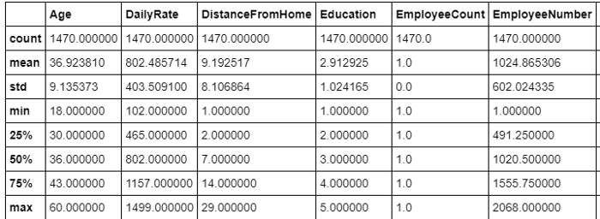

7. Double checking the data set for any missing values.
returned a value = False, indicates that there are no missing values
8. Viewing some basic statistics about the data like the percentile, mean , maximum, minimum etc.
9.Get a count of the number of employee attrition, the number of employees that stayed (no) and the number that left (yes) the company.

Slide 13
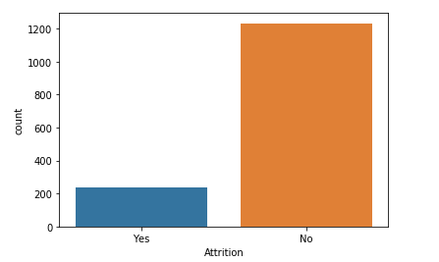
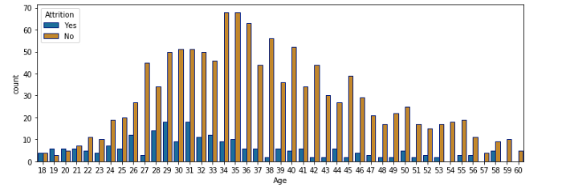
10.Now that we have the count, let’s get a visual of it.
11.Show the number of employees that left and stayed at the company by age.
Here the age with the highest count of employee attrition is age 29 & 31. The age with the highest retention is age 34 & 35.

Slide 14
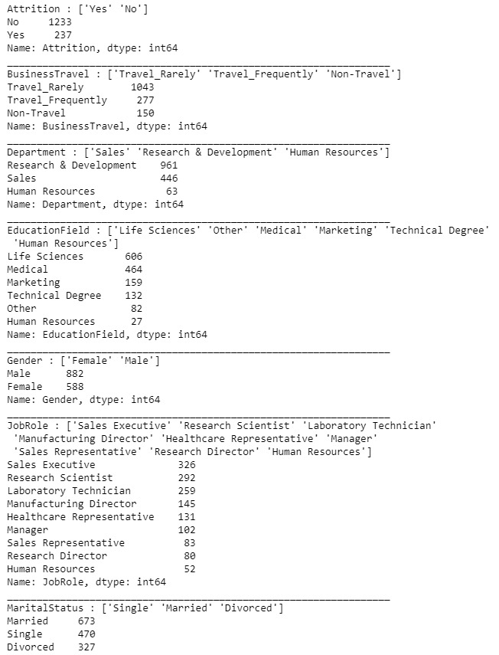
12. Print all of the object data types and print their unique values.
13.Remove unneeded columns

Slide 15
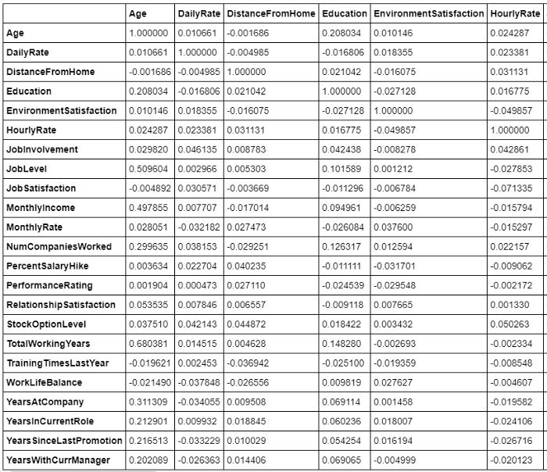
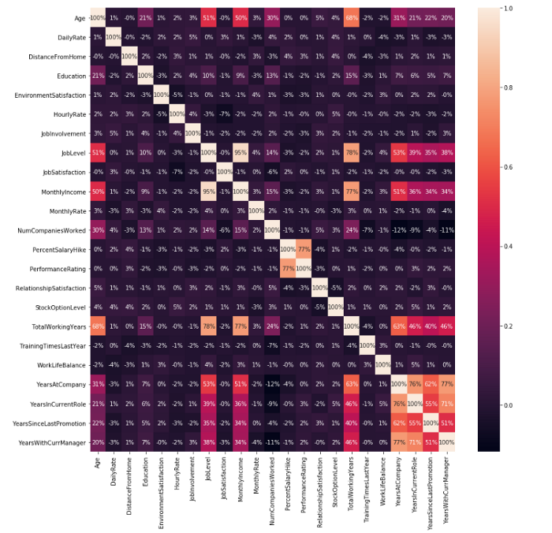
14.Getting the correlation of the columns.
15.Visualizing the correlation by using a heat map.

Slide 16

16. Spliting the dataset into 75% Training set and 25% Testing set.
17. Now by using the Random Forest Classifier to learn from the training data and see how accurate it is on that data.
18. Now get the accuracy of the model.
The model is about 97.9% accurate on the training data
19. Now Showing the confusion matrix and accuracy of the model.
The model correctly identified 86.41% of the employees that left the company.

Slide 17
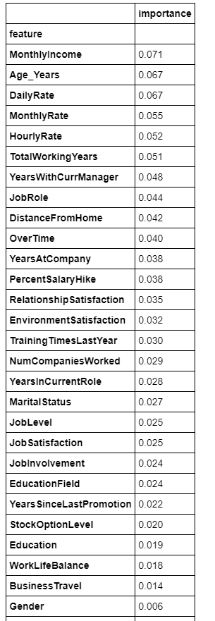
20. Now let’s see what the model thinks the important features are.
21. Visualizing the importance

Slide 18
Architecture
DATASET
REMOVE IRRELEVANT DATA
TEST DATASET
TRAINING DATASET
IDENTIFY FEATURES
DATA PRE-PROCESSING
RANDOM FOREST ALGORITHM
DETECT FACTORS OF ATTRITION
PROVIDE RESULTS AND PREVENTITIVE STEPS

Slide 19
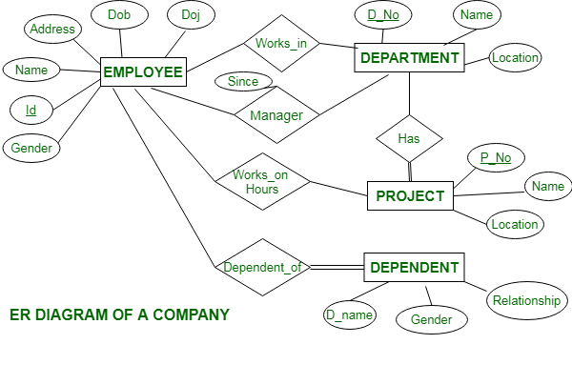
SYSTEM DESIGN
E-R DIAGRAM

Slide 20
DATAFLOW DIAGRAM
START
COLLECTING A PLURALITY OF ATTRIBUTES ASSOCIATED WITH EMPLOYEES
APPLYING MACHINE LEARNING ALGORITHM TO IDENTIFY THE PATTERN
USING THE IDENTIFIED PATTERN TO PREDICT THE REASON FOR THE ATTRITION
PROVIDING THE INFORMATION TO THE MANAGER
END

Slide 21
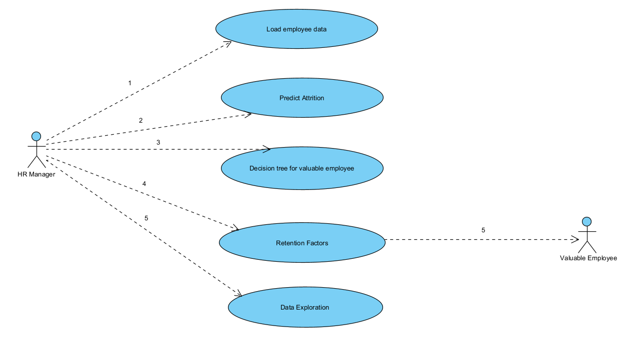
USE CASE DIAGRAM

Slide 22
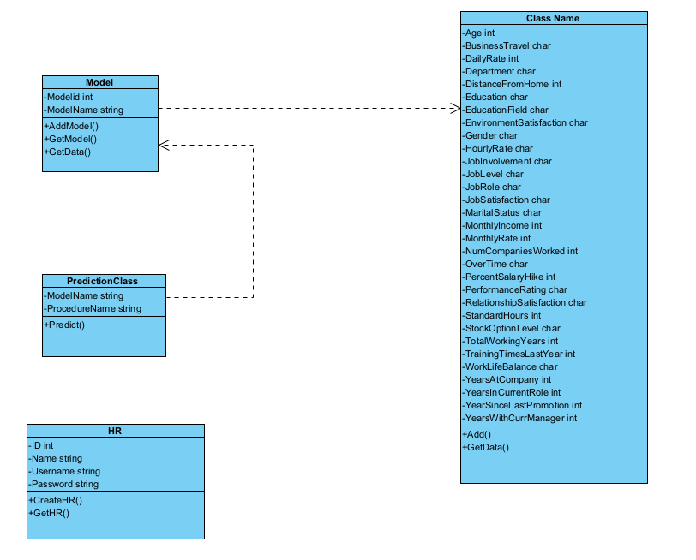
CLASS DIAGRAM

Slide 23
HARDWARE AND
SOFTWARE REQUIREMENTS
SOFTWARE REQUIREMENTS:
GOOGLE COLLAB
GOOGLE CHROME
HARDWARE REQUIREMENTS:
n1-highmem-2 instance
2vCPU @ 2.2GHz
13GB RAM
100GB Free Space
idle cut-off 90 minutes
maximum 12 hours
GPU instance downgraded to 64GB disk space

Slide 24
PERFORMANCE EVALUATION
The dataset is a good representative of the general workforce in today's organizations. The result from the random forest classifier justify that the features chosen are causes that contribute to voluntary attrition.
Intuitively, data points that are close to each other are likely to have the same outcome of attrition. This is the basis for choosing random forest algorithm. The random forest classifier has good accuracy values, the prediction accuracy using the original dataset is about 91%, whereas it is about 94% using a synthetic dataset. Instead of constructing a general model, it simply stores instances of the data and classifies by a majority vote of the classes.

Slide 25
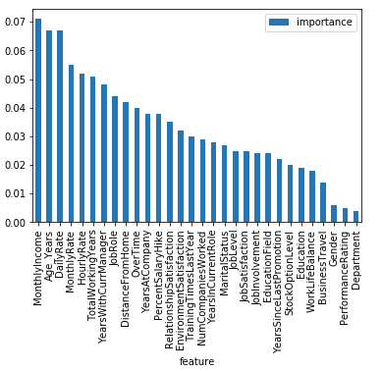
SCREENSHOT
Monthly income appears to be the most important feature followed by the persons age, daily rate, and monthly rate.

Slide 26
CONCLUSION
Employee attrition effects in financial, time and effort loss of organizations.
It is a big issue since a trained and experienced employee is difficult to substitute and its cost effective.
We try to find to analyze the past and existing employees information to estimate the future attritioners and study the reasons of employee turnover.
The results of this learning describe that data extraction algorithms can be utilized to construct reliable and accurate predictive methods for employee attrition.
The issue of employee attrition identification is not just to depict attritioners from no attritioners .
By using the tentative data study and data extraction methods, we can depict the attrition probability for each one employee and provide them score to build the retention techniques.

Slide 27
REFERENCES
Jarrahi, M.H. Artificial intelligence and the future of work: Human-AI symbiosis in organizational decision making. Bus. Horiz. 2018, 61, 577–586. [CrossRef]
Duan, Y.; Edwards, J.S.; Dwivedi, Y.K. Artificial intelligence for decision making in the era of Big Data—Evolution, challenges and research agenda. Int. J. Inf. Manag. 2019, 48, 63–71. [CrossRef]
Fallucchi, F.; Coladangelo, M.; Giuliano, R.; William De Luca, E. Predicting Employee Attrition Using Machine Learning Techniques. Computers 2020, 9, 86. [CrossRef]
Zelenski, J.M.; Murphy, S.A.; Jenkins, D.A. The Happy-Productive Worker Thesis Revisited. J. Happiness Stud. 2008, 9, 521–537. [CrossRef] Computers 2021, 10, 141 11 of 11
Varian, H.; 16. Artificial Intelligence, Economics, and Industrial Organization. In The Economics of Artificial Intelligence: An Agenda; University of Chicago Press: Chicago, IL, USA, 2019; pp. 399–422.
Vardarlier, P.; Zafer, C. Use of artificial intelligence as business strategy in recruitment process and social perspective. In Digital Business Strategies in Blockchain Ecosystems; Springer: Cham, Switzerland, 2020; pp. 355–373.
Alduayj, S.S.; Rajpoot, K. Predicting Employee Attrition using Machine Learning. In Proceedings of the 2018 International Conference on Innovations in Information Technology (IIT), Al Ain, United Arab Emirates, 18–19 November 2018; pp. 93–98. [CrossRef]
Usha, P.M.; Balaji, N. Analysing employee attrition using machine learning. Karpagam J. Comput. Sci. 2019, 13, 277–282.
Setiawan, I.; Suprihanto, S.; Nugraha, A.; Hutahaean, J. HR analytics: Employee attrition analysis using logistic regression. In IOP Conference Series: Materials Science and Engineering; IOP Publishing: Bandung, Indonesia, 2020; Volume 830, p. 032001.
Rupa Chatterjee Das, A.D.S. Conceptualizing the Importance of HR Analytics in Attrition Reduction. Int. Res. J. Adv. Sci. Hub 2020, 2, 40–48. [CrossRef]

Slide 28
FUTURE SCOPE
Predicting the reason that cause the employee to be attrite using psychological factors before attrition is highly effective than predicting the reason for the employee’s attrition after attrition.
So in future, the project works on collecting employee’s psychological factors that may help the company to decide whether to retain the employee or not .

